Slide 1
Protest Data from Berlin
what we have /
what we can do with it
On February. 17

Slide 2
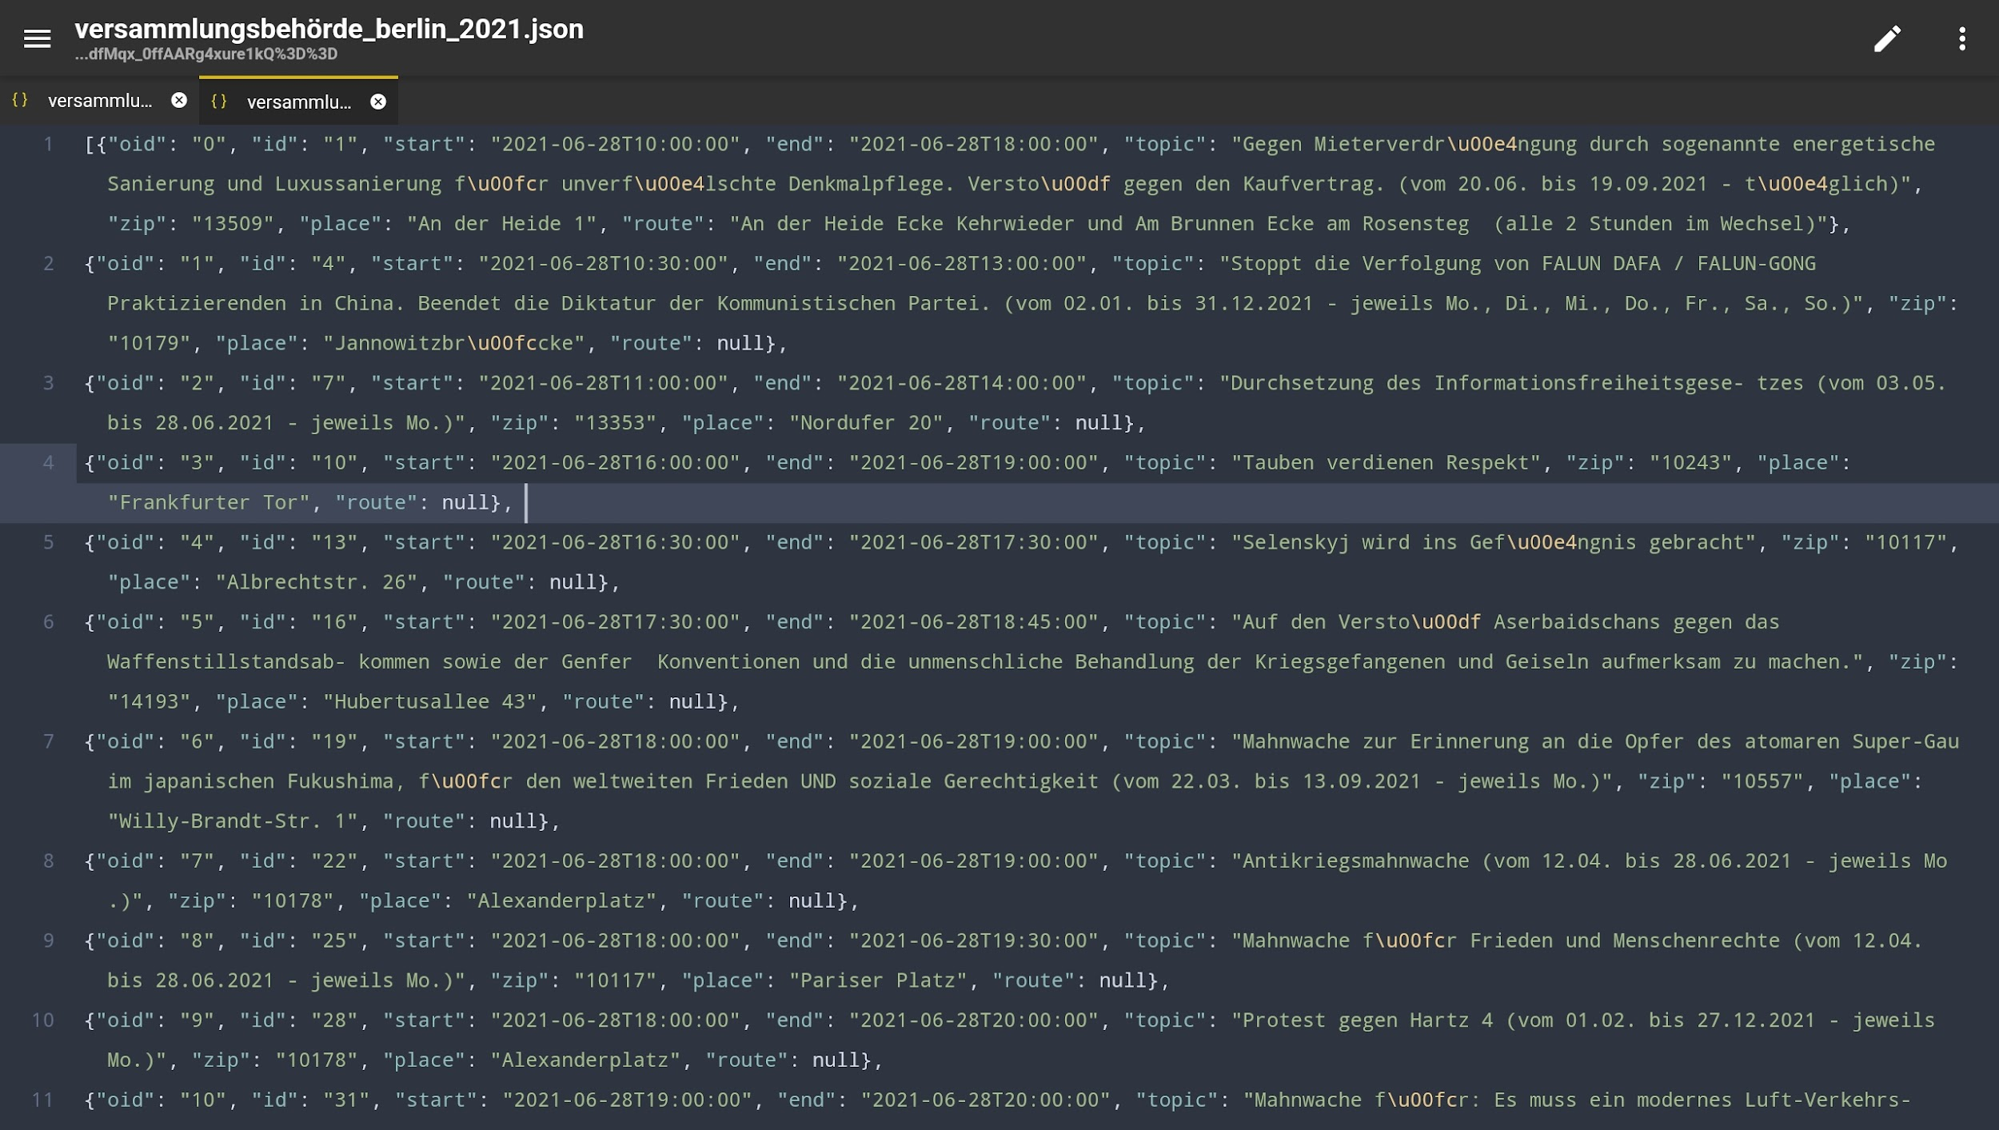
Versammlungsbehörde data; State; 28.06.2021 - 31.12.2021
to be scraped from 01.01.2022- today
column names: oid; id; start(T); end(T); topic; zip; place; route
information: location(start, route), date, time(start, end), topic

Slide 3
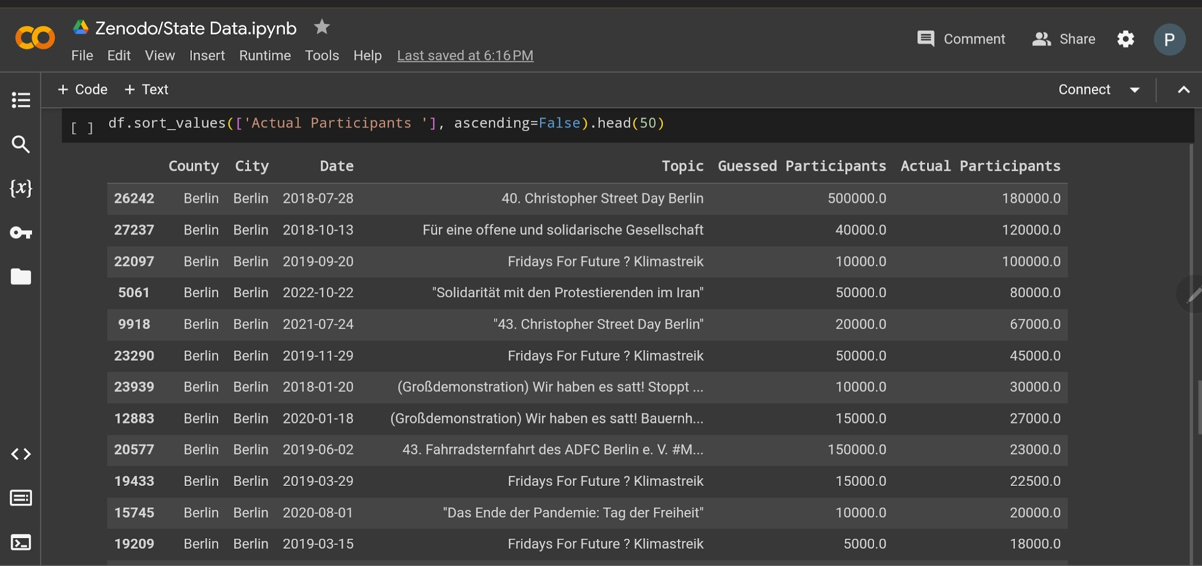
Zenodo(Frag den Staat) Data, State, 2018 - 2022
column names: county; city; date; topic; expected participants; actual participants

Slide 4
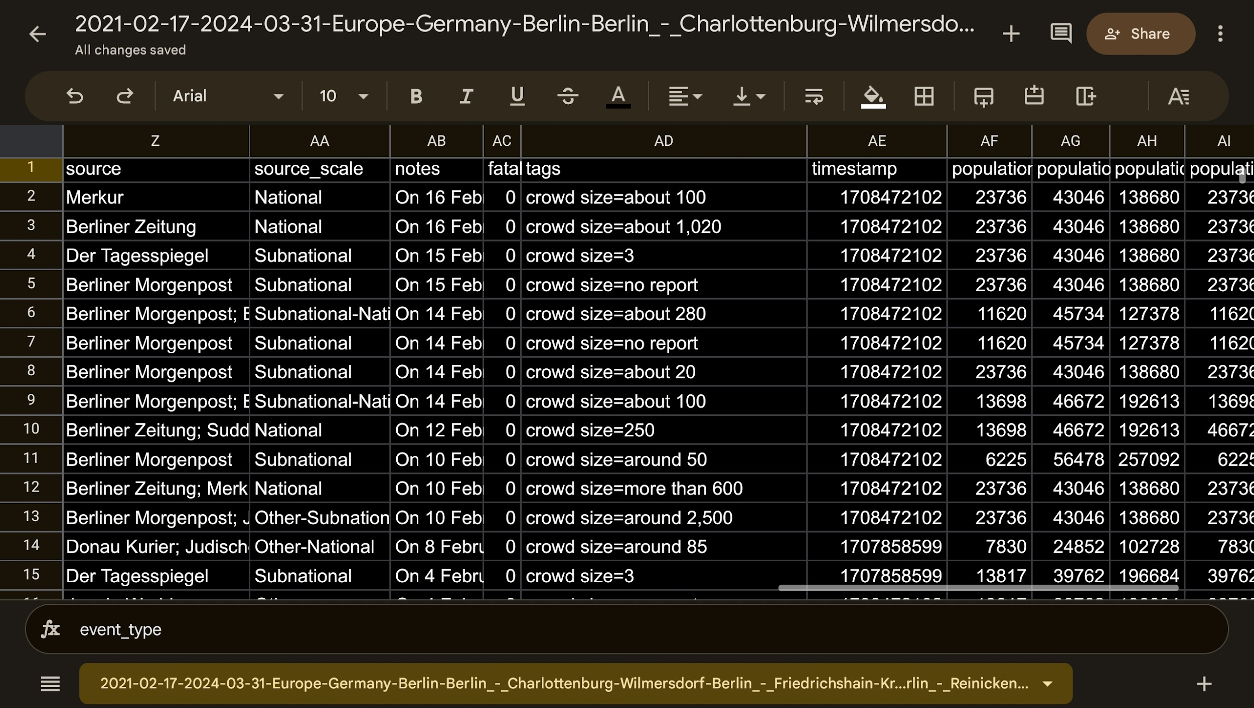
ACLED Data from Berlin; Newspapers; 29.02.2021-16.02.2024
column names: event_id_cnty; event_date; year; time_precision; disorder_type; event_type; sub_event_type; actor1; assoc_actor_1; inter1; actor2; assoc_actor_2; inter2; interaction; civilian_targeting; iso; region; country; admin1; admin2; admin3; location; latitude; longitude; geo_precisio information: event type: riot or protest; subtype: violent or non-violent; organization names; newspaper: names, national or city news, time reported; location: quarters, latitude, longitude, population of quarters, …; crowd size;

Slide 5
Data Science
Working on ACLED Data to estimate Participants on a protest, …
Regression
Translate all data to english
count the protest that are sorted into topics

Slide 6
Deep Learning
Scrape Versammlungsbehörde Data
Versammlungsbehörde Data:
Work on State Data to filter out the organization names, … from topic
Vizualize analyzation in MAP

Slide 7
Deep Learning
By using the Versammlungen im Land Berlin data we can have regression and classification tasks. Regression is a type of supervised learning task where the goal is to predict a continuous target variable.
In regression, the output variable takes continuous values. For example duration of protest in the future.
We can evaluate the regression model with some metrics like Mean Squared Error (MSE), Root Mean Squared Error (RMSE), Mean Absolute Error (MAE), etc.
In classification, the output variable takes categorical values. For example, next protest area can predict depends on the zip and street.
We can evaluate the classification model with some metrics like accuracy, precision, recall, F1-score, etc.

Slide 8
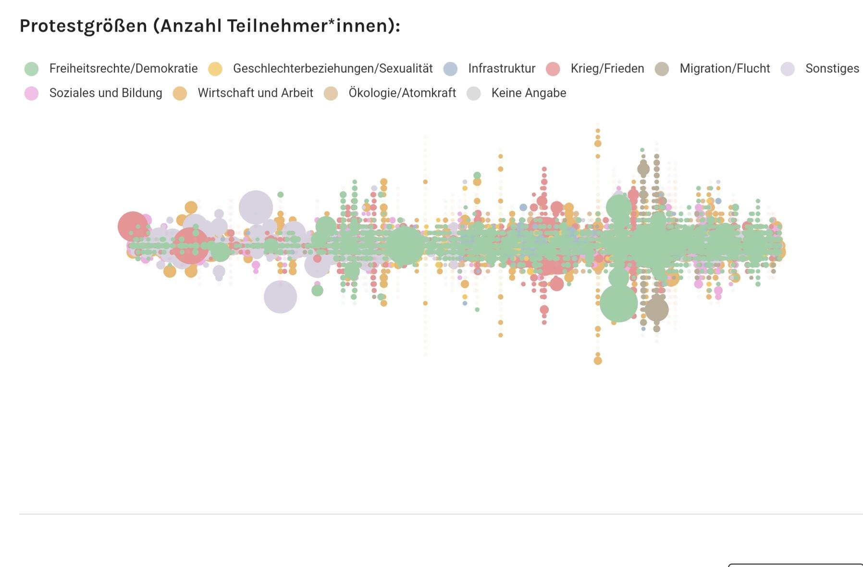
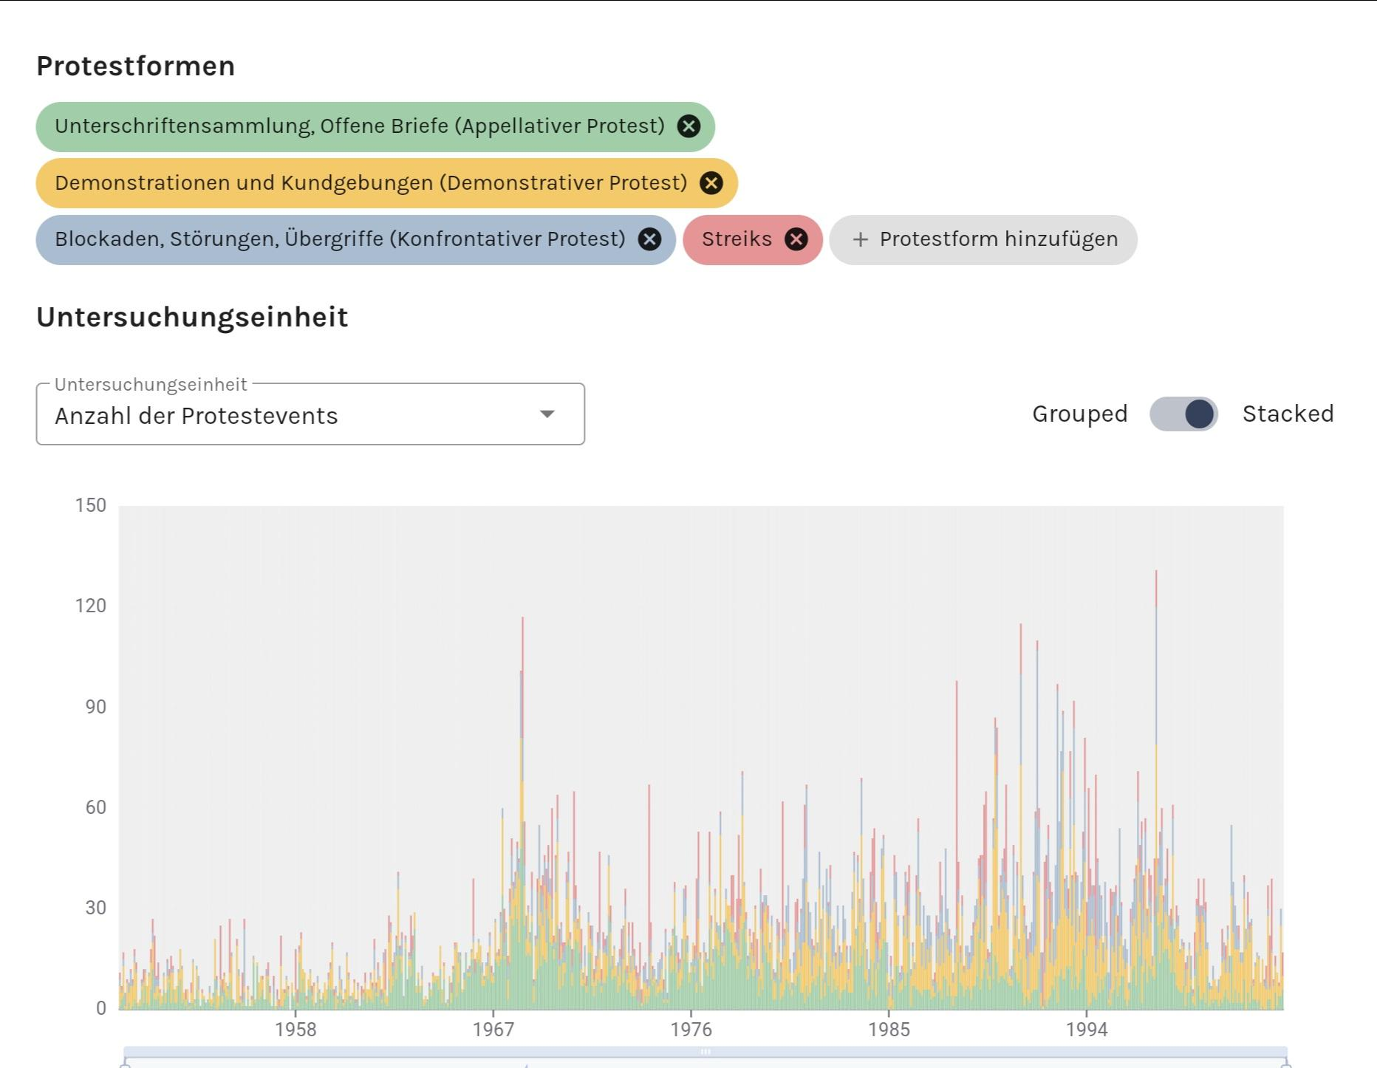
what we can maybe do with it: analyzation
links: https://protestdata.eu/bundesweite-analyse

Slide 9
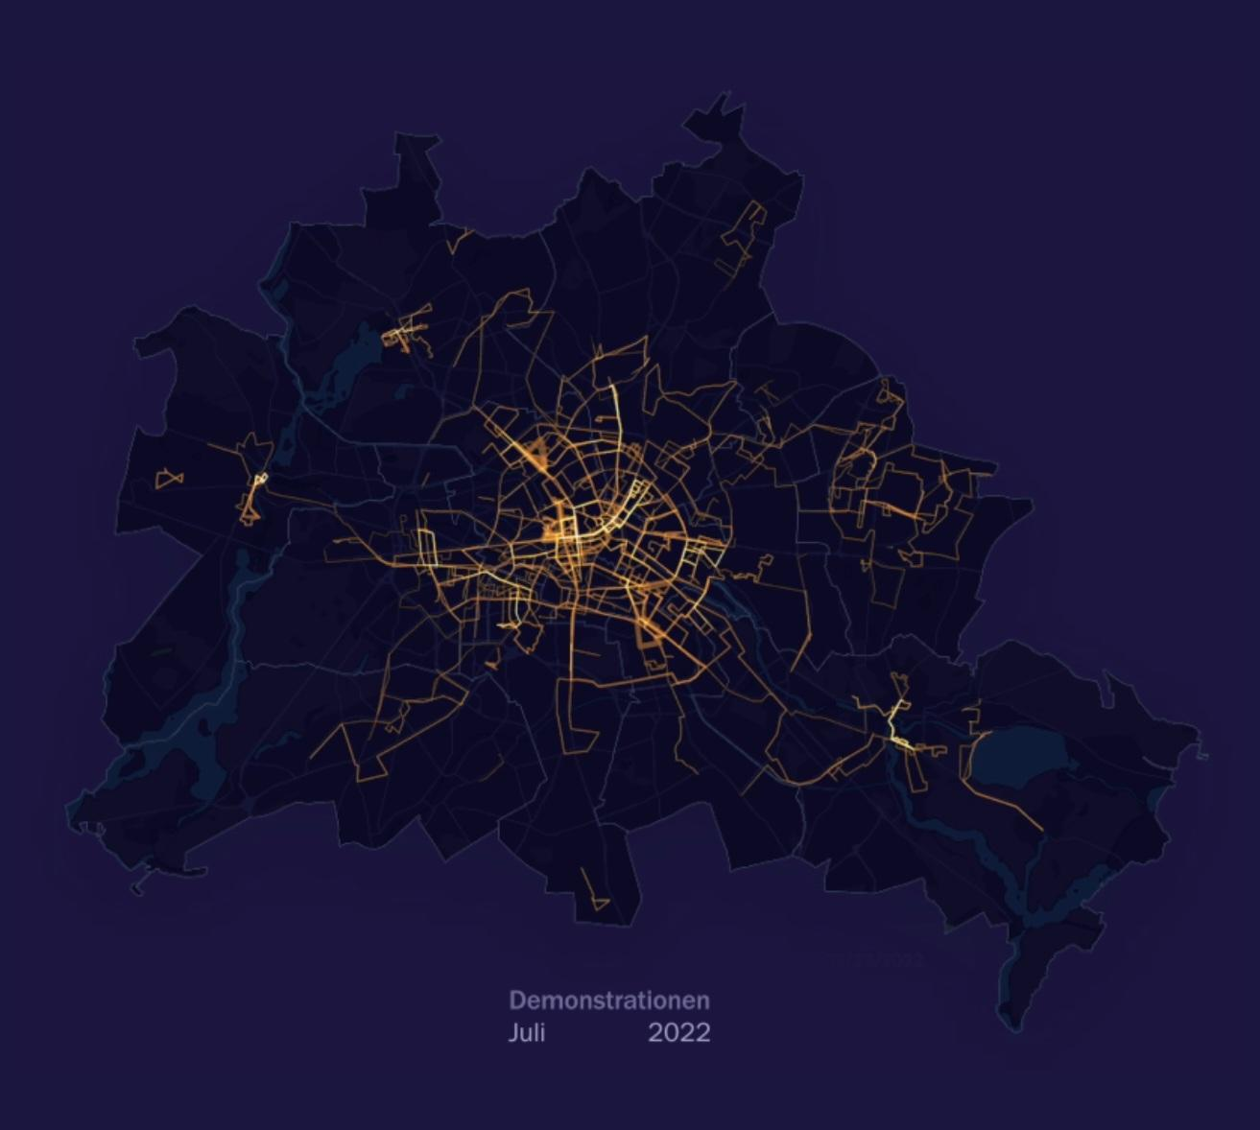
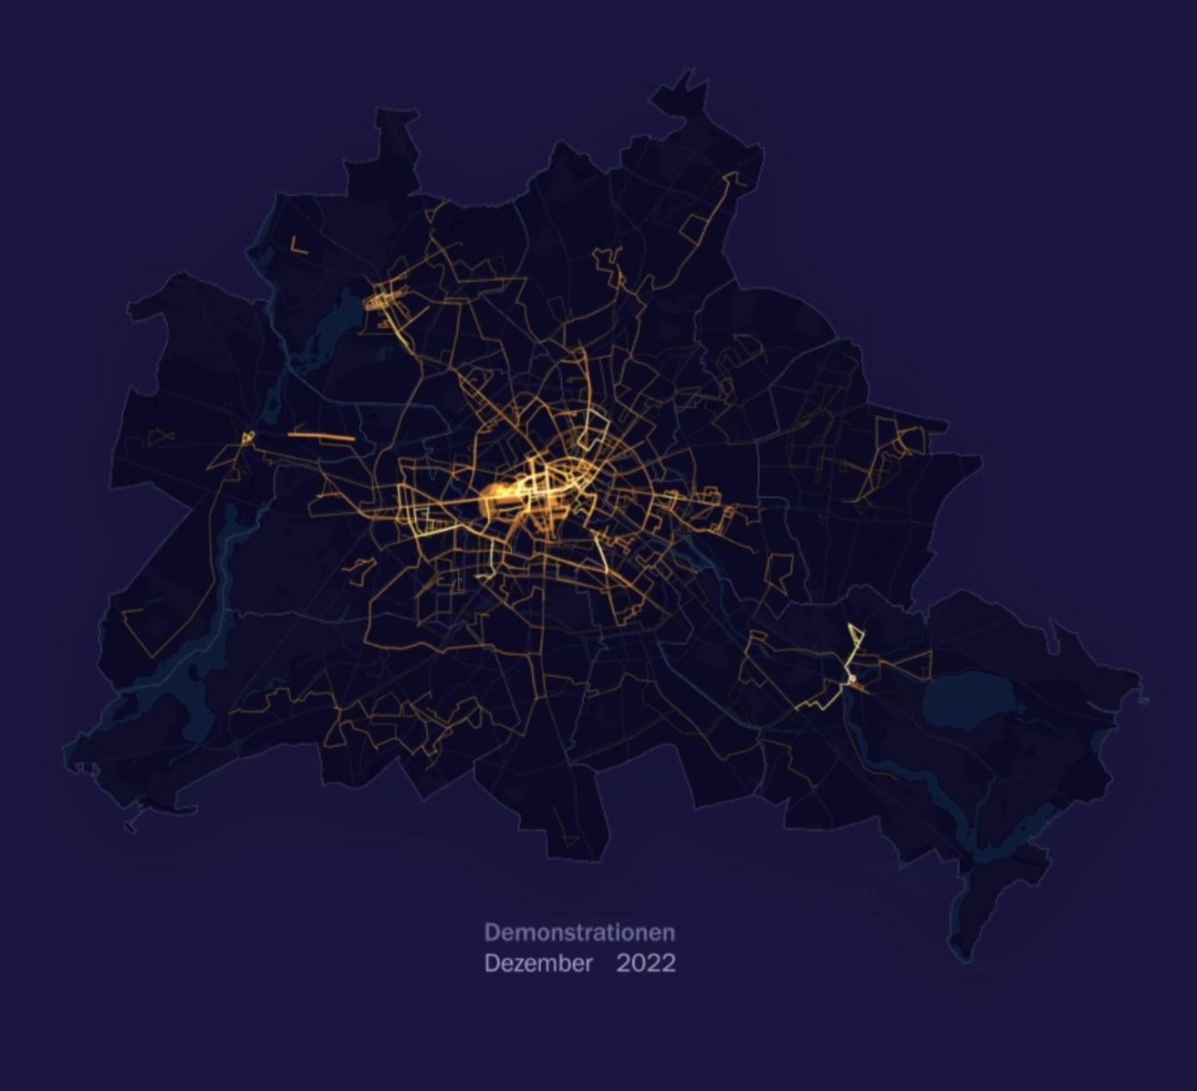
links: https://interaktiv.tagesspiegel.de/lab/demo-atlas-berlin-wofuer-wird-in-meiner-nachbarschaft-demonstriert/

Slide 10
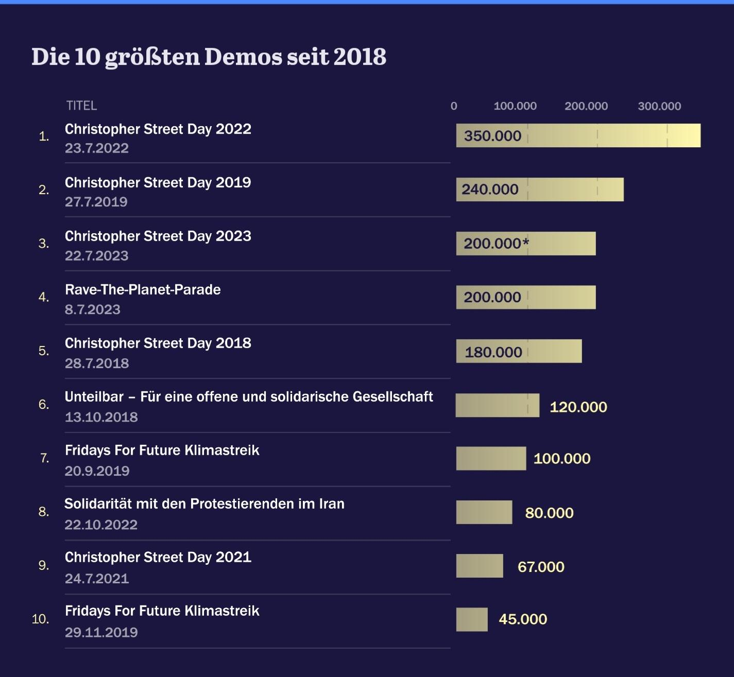
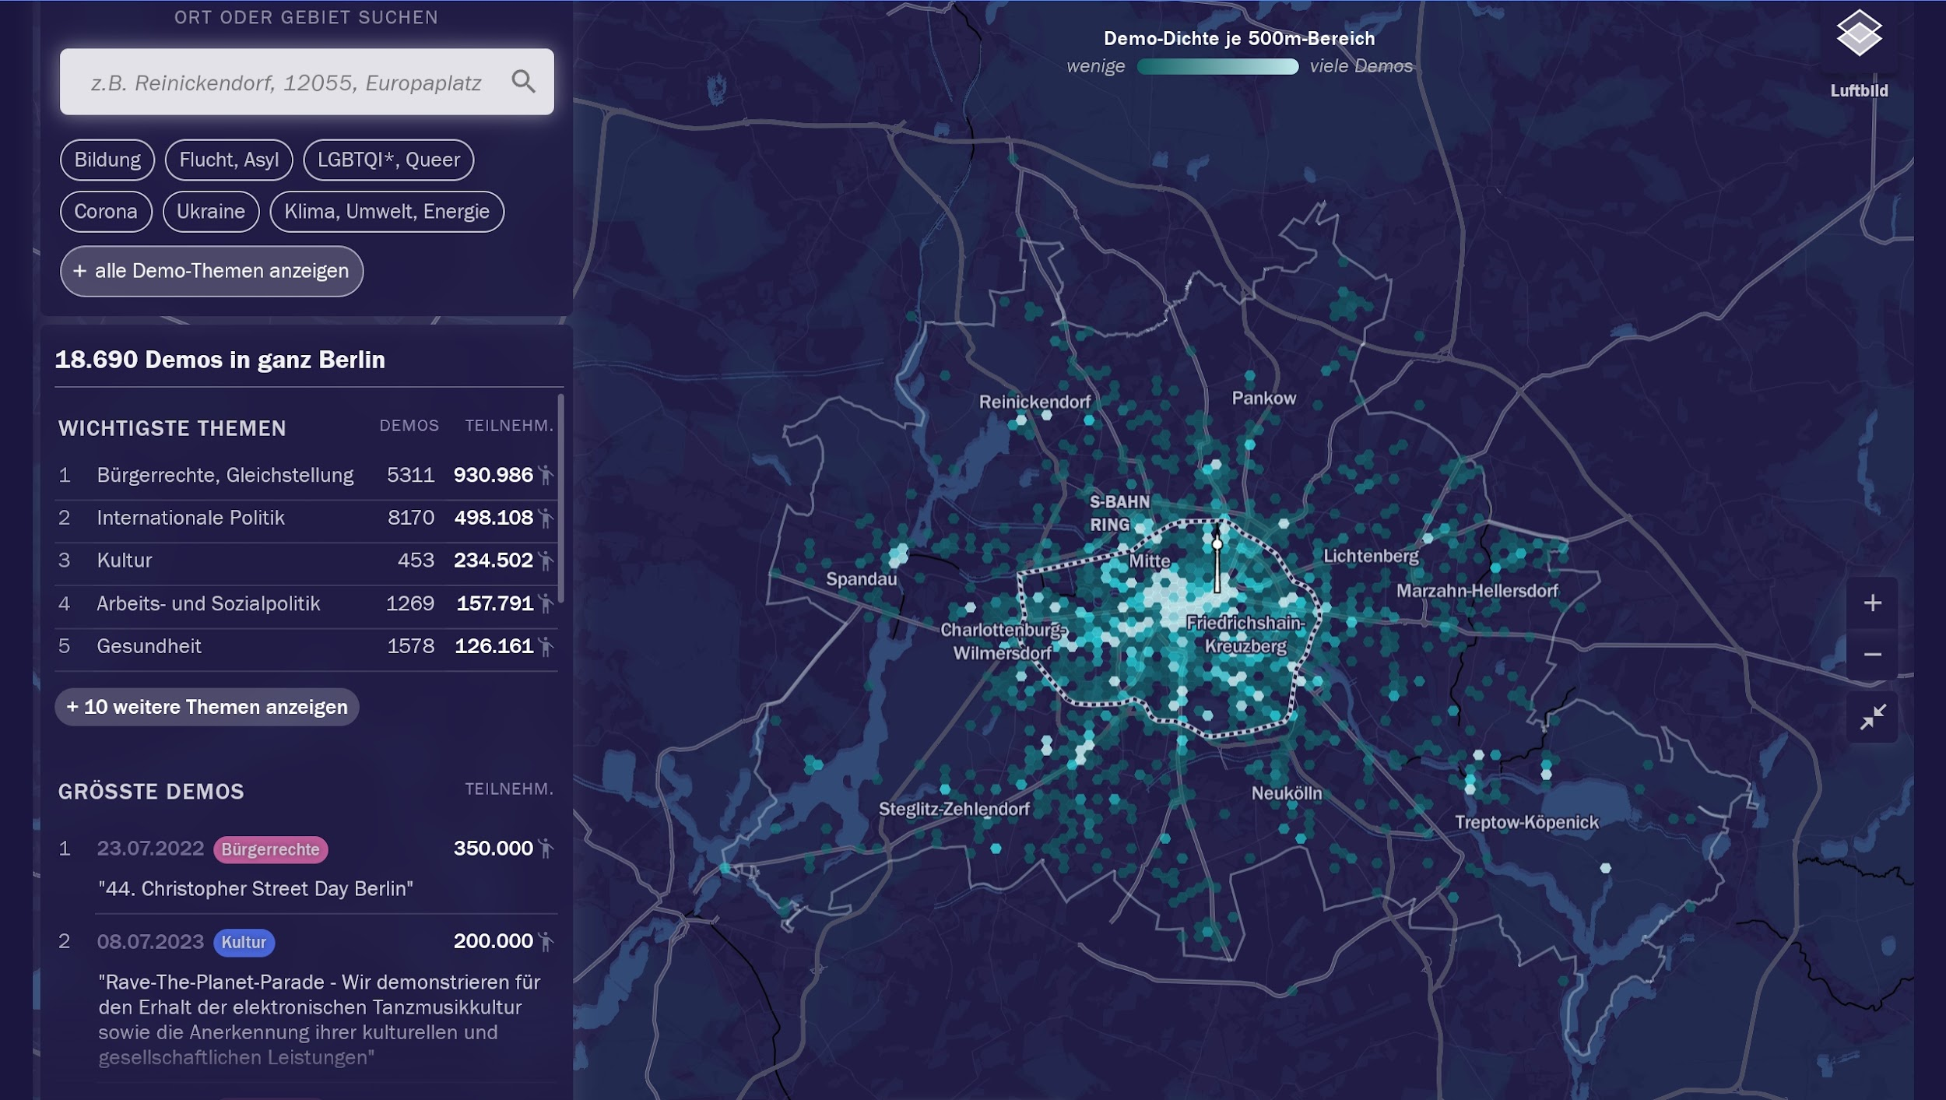

Slide 11
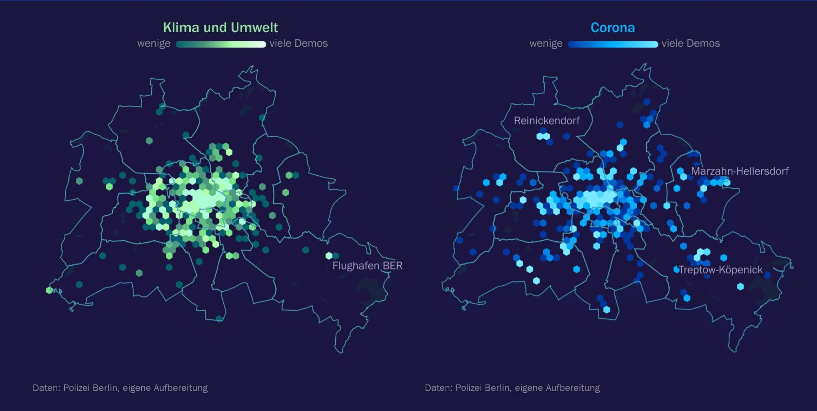

Slide 12
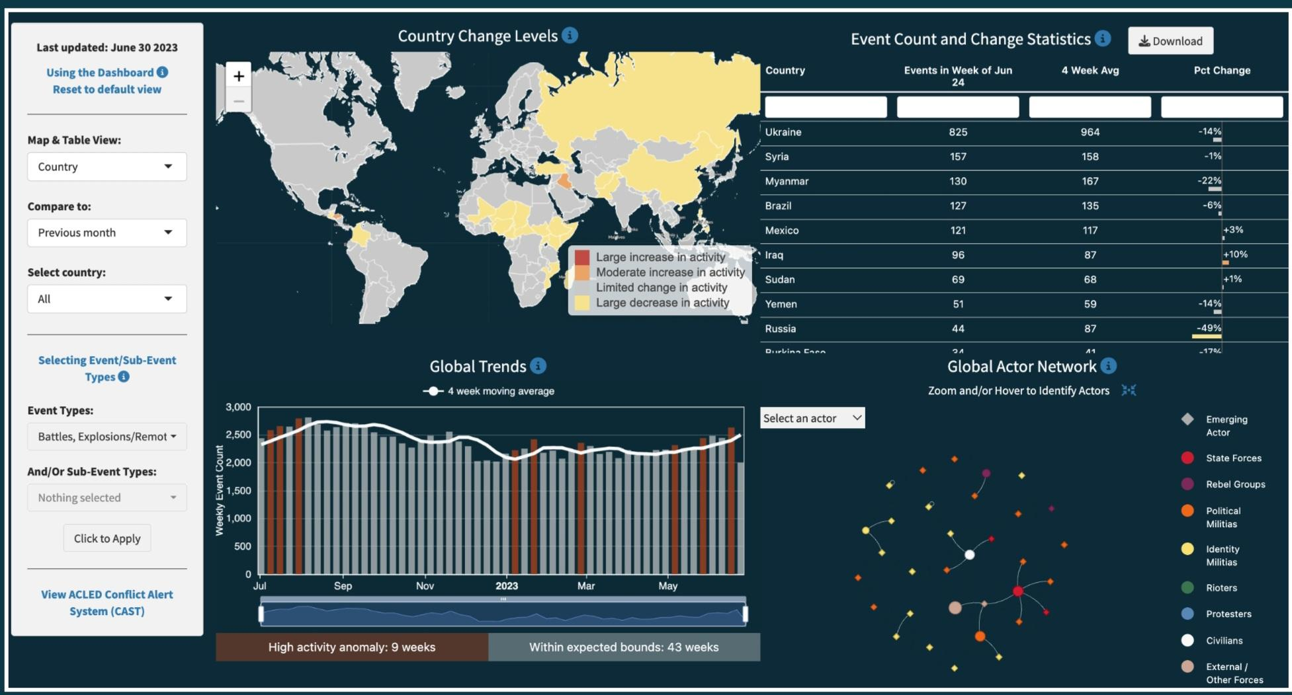
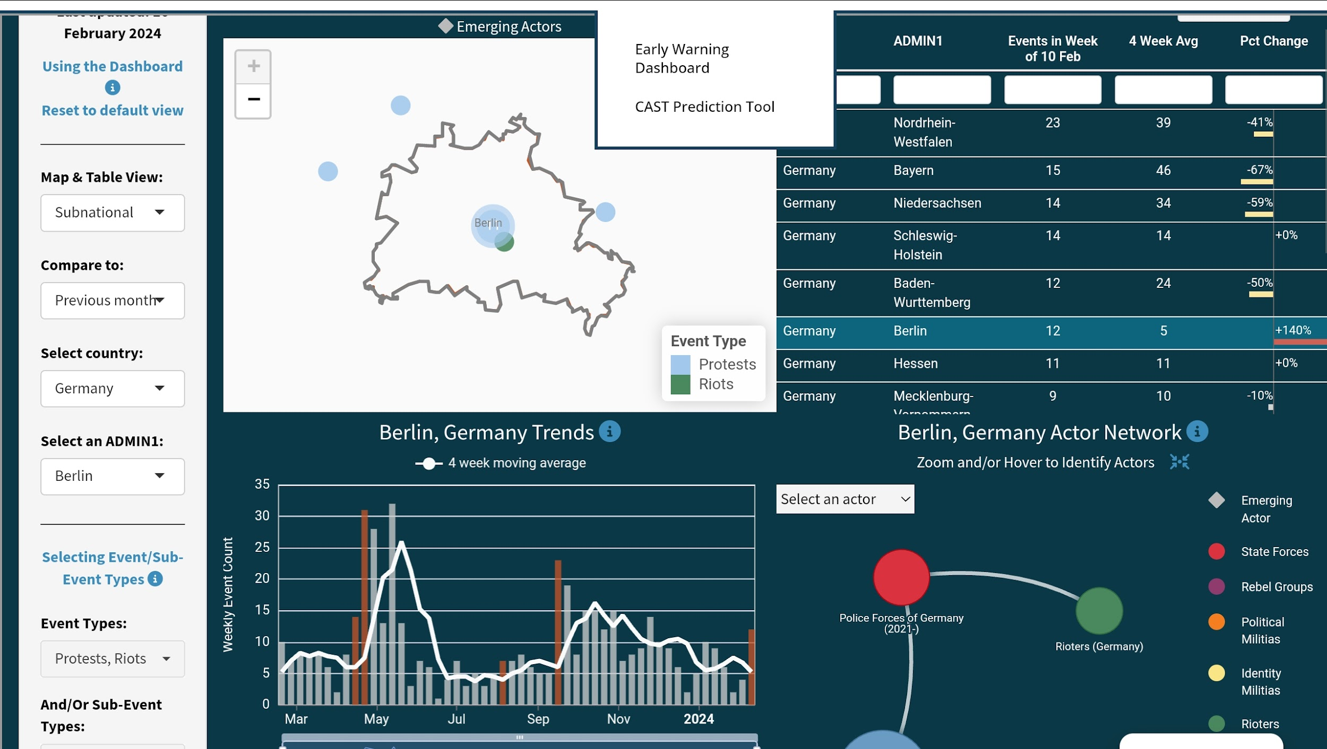
what we can maybe do with it: predictions
https://protestdata.eu/bundesweite-analyse

Slide 13
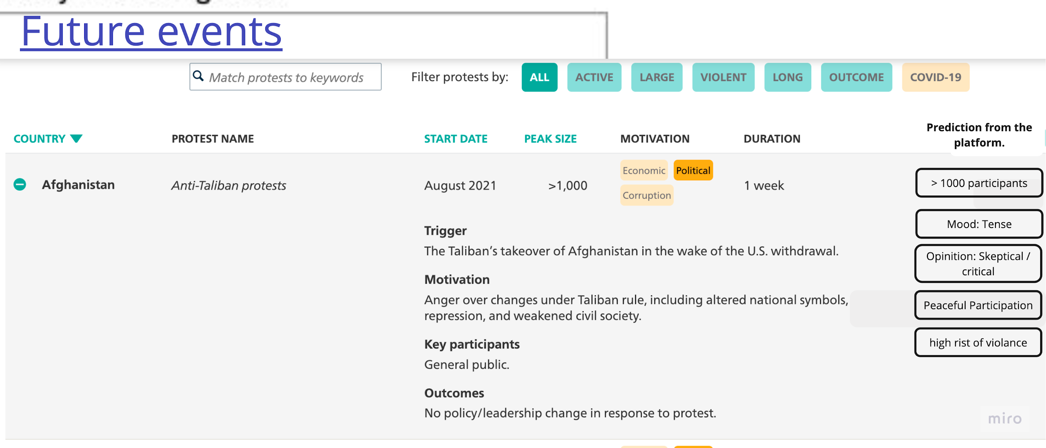
Ideas how to present data:
https://carnegieendowment.org/publications/interactive/protest-tracker#

